Slide 1



Title
Host Conference Name
Paper Number
Speaker Name, Affiliation
Co-Author Names
Presentation Date, Start Time-End Time
Text
Text
Text
Text

Slide 2

Bilingual Broadcasts
2nd Symposium on Diversity, Equity and Inclusion
2.1
Jen Ives, AMS
Co-Authors: Marissa Welch, AMS and Ricky Sidla, AMS
Friday, 15 January 2021, 10:15am-10:20am
Text
Text
Text
Text

Slide 3
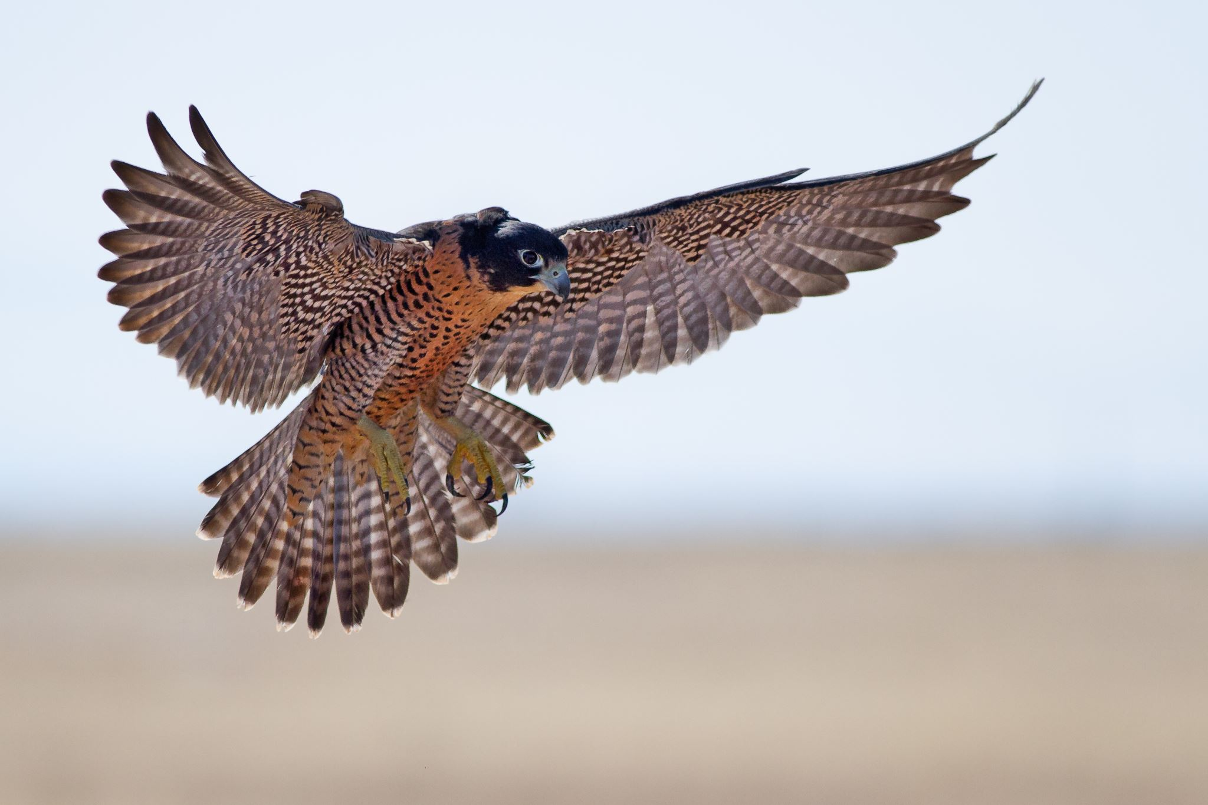

Bilingual Broadcasts
2nd Symposium on Diversity, Equity and Inclusion
2.1
Jen Ives, AMS
Co-Authors: Marissa Welch, AMS and Ricky Sidla, AMS
Friday, 15 January 2021, 10:15am-10:20am
Text
Text
Text
Text

Slide 4

Title
Host Conference Name
Paper Number
Speaker Name, Affiliation
Co-Author Names
Presentation Date, Start Time-End Time
Text
Text
Text
Text

Slide 5
Bilingual Broadcasts
2nd Symposium on Diversity, Equity and Inclusion
2.1
Jen Ives, AMS
Co-Authors: Marissa Welch, AMS and Ricky Sidla, AMS
Friday, 15 January 2021, 10:15am-10:20am
Text
Text
Text
Text
Text
Text

Slide 6
Bilingual Broadcasts
2nd Symposium on Diversity, Equity and Inclusion
Paper 2.1
Jen Ives, AMS
Co-Authors: Marissa Welch, AMS and Ricky Sidla, AMS
Friday, 15 January 2021, 10:15am-10:20am
Text
Text
Text
Text
Text
Text
Text

